Slide 1
Ordinary Differential Equations 1: Euler Method
AMSC/CMSC 460
Dr. Christopher Moakler

Slide 2
What we’ve seen so far
So far in this course we’ve solved myriad different sorts of problems.
These have included,
Root Finding
Systems of Linear Equations
Eigenvalues
Least Squares
Interpolation
Numerical Differentiation and Integration
All these problems have countless applications and are encountered frequently by scientists and engineers.

Slide 3
Where we’re headed
However, a lot of modern-day research revolves around solving differential equations of all sorts.
Every physical process we know can be modeled by a differential equation.
If we can find solutions to those differential equations, we can model anything!
The issue, obviously, is we can’t always find a solution to every differential equation we encounter.
For example,
A stellar system with many masses.
A system consisting of many bodies with electric charges.
A fluid system moving around an airfoil.
A chemical system consisting of many molecules.

Slide 4
More about the chemical system
Chemical systems are an excellent example of how complicated things can get.
To begin the analysis, we start with Newton’s famous formula,
$$\sum{F}=m\ddot{x}$$
here the double dot indicates the second derivative w.r.t. time.
What forces are acting on the molecules of this system?
There are a lot!

Slide 5
Reminder about Diff Eq terminology
Before we get too deep into numerical approaches, let’s remind ourselves of some vocabulary.
A first order differential equation is one where only the first derivative of the dependent variable occurs.
$$\dot{y}=f(t)$$
$$\dot{y}=f\left(t,y\right)$$
$$F\left(t,y,\dot{y}\right)=0$$
A second order differential equation is one where the second derivative of the dependent variable occurs.
$$\ddot{y}=f(t)$$
$$F\left(t,y,\dot{y},\ddot{y}\right)=0$$

Slide 6
Reminder about Diff Eq terminology cont
A differential equation is homogenous if the terms of the equation depend only on the dependent variable or one of its derivatives.
$$\dot{y}+y=0$$
A nonhomgenous differential equation contains a “source” term.
$$\dot{y}+y=f\left(t\right)$$
If none of the derivative terms contain the independent variable, the equation is said to be a constant coefficient ODE.
If not, it’s called a variable coefficient ODE.
$$\dot{y}+yt=f\left(t\right)$$

Slide 7
Initial Value Problems and Boundary Value Problems
The solutions to a differential equation form a class with an infinite number of independent solutions.
This comes from the integration constant students are wont to forget in Calculus class.
To narrow it down to just one solution, we need to introduce auxiliary conditions.
These come most commonly in two flavors,
Initial Value conditions
Boundary Value conditions

Slide 8
Initial Value Problems and Boundary Value Problems contd
Initial value problems are differential equations where the value of the dependent variable is known at the starting point.
The most common example of this comes in kinematic problems.
Recall your physics class where you knew the initial position of an object undergoing free fall.
Boundary Value problems are differential equations where the value of the dependent variable is known at both the start and the end.
An example of this is a finite metal wire kept at a fixed temperature at either end.
This is an example of a Dirichlet boundary condition
This is also seen in electromagnetism where you might know the value of the derivative at a boundary.
This is an example of a Neumann boundary Condition

Slide 9
Propagation problems and Marching Methods
A propagation problem is one where we know the value of a function at a certain point and wish to know the value at future times or places.
These are Initial Value Problems (IVP) and can be approached by “marching” forward and propagating our solution.
These sorts of problems can be of any order higher than one.

Slide 10
Finite Difference Approximations
We can approximate the Ordinary Differential Equation, ODE, with a Finite Different Equation, FDE.
To form an FDE, we first need to discretize the space we’re interested in.
Since we’re working with ODEs, this space is one-dimensional.
Thus, to discretize the space, we break the interval up into subintervals.
Hoffman

Slide 11
Finite Difference Approximations cont
We can look at the Taylor expansion of the solution at the (n+1)th position,
$$y_{n+1}=y_{n}+\dot{y_{n}}∆t+\frac{1}{2}\ddot{y_{n}}{\left(∆t\right)}^{2}+…$$
We can also write this as a finite series with an error term as we have previously,
$$y_{n+1}=y_{n}+{\dot{y}}_{n}∆t+\frac{1}{2}{\ddot{y}}_{n}{\left(∆t\right)}^{2}+\frac{1}{\left(m+1\right)!}y^{\left(m+1\right)}\left(τ\right){\left(Δt\right)}^{m+1}$$
If we solve for ${\dot{y}}_{n}$ we get,
$${\dot{y}}_{n}=\frac{y_{n+1}−y_{n}}{Δt}−\frac{1}{2}{\ddot{y}}_{n}Δt−…$$

Slide 12
Finite Difference Approximations cont
If we truncate this expansion after the first term we get,
$${\dot{y}}_{n}=\frac{y_{n+1}−y_{n}}{Δt}−\frac{1}{2}{\ddot{y}}_{n}\left(τ\right)Δt$$
And if we leave off the error term, we get,
$${\dot{y}}_{n}≈\frac{y_{n+1}−y_{n}}{Δt}$$
This is a first-order forward-difference approximation.

Slide 13
A backward Finite Difference Approximation
We can also form a backward-difference approximation similarly.
Take the approximation of $y_{n}$,
$$y_{n}=y_{n+1}+\dot{y_{n+1}}(−∆t)+\frac{1}{2}\ddot{y_{n}}{\left(−∆t\right)}^{2}+…$$
Solve for $y_{n+1}$ this time and perform a similar truncation as before to get
$${\dot{y}}_{n+1}=\frac{y_{n+1}−y_{n}}{Δt}−\frac{1}{2}{\ddot{y}}_{n}\left(τ\right)Δt$$
Removing the error terms gives us,
$${\dot{y}}_{n+1}≈\frac{y_{n+1}−y_{n}}{Δt}$$

Slide 14
Second-order centered-difference approximation
We can also form a second-order approximation by approximating $y$ at the grid point (n + ½).
You form two such approximation, one for $y_{n}$ and one for $y_{n+1}$.
You then subtract these two approximation to get,
$${\dot{y}}_{n+\frac{1}{2}}=\frac{y_{n+1}−y_{n}}{Δt}−\frac{1}{24}\overset{⃛}{y}\left(τ\right){\left(Δt\right)}^{2}$$
Leaving off the error terms gives us
$${\dot{y}}_{n+\frac{1}{2}}≈\frac{y_{n+1}−y_{n}}{Δt}$$

Slide 15
Comparing the different methods
Let’s collect all the different approximations in one slide,
$${\dot{y}}_{n}≈\frac{y_{n+1}−y_{n}}{Δt}$$
$${\dot{y}}_{n+1}≈\frac{y_{n+1}−y_{n}}{Δt}$$
$${\dot{y}}_{n+\frac{1}{2}}≈\frac{y_{n+1}−y_{n}}{Δt}$$
Notice anything?
All of them have the exact same equation on the right-hand side!
The only difference between them occurs in the error term.

Slide 16
Euler Method
Most of these, so far, are equations we’ve talked about, at least briefly, when discussing numerical differentiation.
We now need to apply these approximations to actually solve an ODE.
To do so, we take one of our FDAs and plug it into an ODE.
For example, if we have an ODE,
$\dot{y}=f(t,y)$.
We discretize it as,
$${\dot{y}}_{n}=f(t_{n},y_{n})$$
Plug in
$${\dot{y}}_{n}≈\frac{y_{n+1}−y_{n}}{Δt}$$
To get,
$$y_{n+1}=y_{n}+Δt∗f(t_{n},y_{n})$$

Slide 17
Euler Method Contd
This is often called the Euler Method.
Sometimes it’s called the Forward Euler Method
This is an explicit finite difference equation.
This is easier to implement
$$y_{n+1}=y_{n}+Δt∗f(t_{n},y_{n})$$

Slide 18
Backward Euler Method
We could have also plugged in,
$${\dot{y}}_{n+1}≈\frac{y_{n+1}−y_{n}}{Δt}$$
Solving this gives
$$y_{n+1}=y_{n}+Δt∗f(t_{n+1},y_{n+1})$$
This is an implicit finite difference equation since it depends on the value of $y_{n+1}$.
This ultimately requires us to solve an equation which can take a lot of computation time.
This is often called the Backward Euler Method.

Slide 19
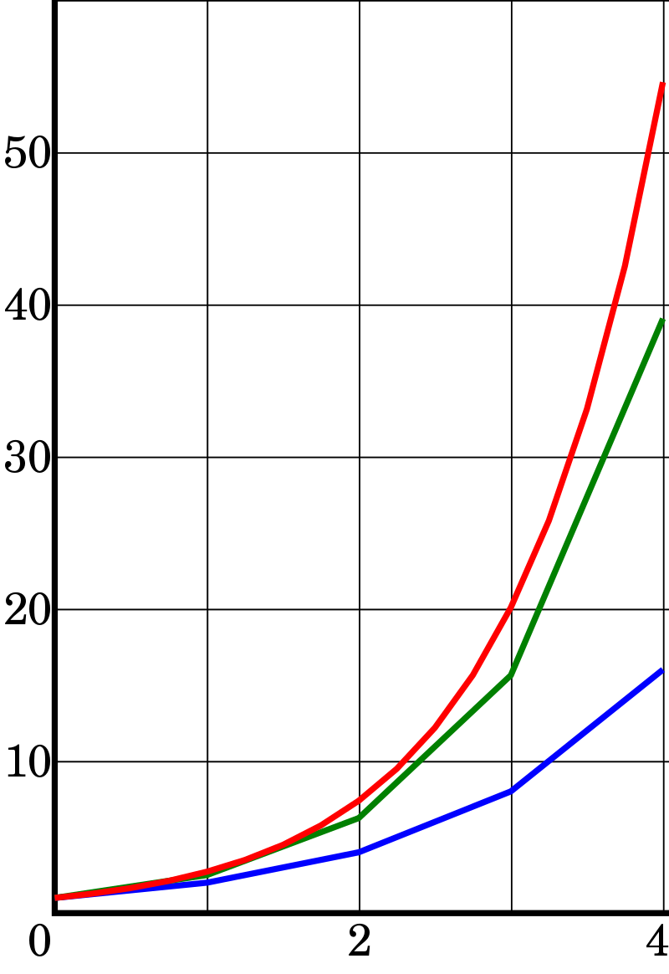
https://en.wikipedia.org/wiki/Euler_method
Solution to y’=y. Exact (red) Midpoint with h = 1 (Green)
Euler Method with h = 1 (Blue)
Solution to y’=y. Exact (red) Midpoint with h = 0.25 (Green)
Euler Method with h = 0.25 (Blue)

Slide 20
Euler Method Instability
Hoffman

Slide 21
Backward Euler Method Stability
Hoffman

Slide 22
Stability and Overshoot
Forward Euler is conditionally stable.
In the previous example it was stable only for $Δt≤2$
The “wiggly” behavior for $1≤Δt≤2$ is called “overshoot”
The overshoot is not necessarily instability, however if it grows to large, it can certainly lead to instability.
Typically, you need to make the step size half the size of the largest stable step size.
Backward Euler is unconditionally stable.
This makes it INCREDIBLY powerfully if we can justify the cost of the implicit nature.

Slide 23
Euler Method Properties
Euler Method is explicit; it does not depend on $y_{n+1}$.
Euler Method requires only one known point to evaluate, it is thus a single point method.
Euler method requires evaluation of the function at only one point at every step.
Euler Method has a truncation error of order 2 for a single step.
Euler method has a global accumulated error of first order after N steps.

Slide 24
Backward Euler Method Properties
Backward Euler method is implicit since you need to evaluate the function at the (n+1)th grid point.
If the function is linear, the solution is easy to compute.
If it’s nonlinear, it can require more effort.
Backward Euler Method is a single point method.
Backward Euler only requires one function evaluation per step if the function is linear.
Although it may require many more evaluations to solve the resulting equation.
Backward Euler has a single step error of second order and a global error of first order.

Slide 25
The Trapezoidal Method
We can also obtain a higher order method by utilizing the trapezoidal rule for numerical integration.
Take the equation
$$y_{n+1}=y_{n}+\int_{t_{n}}^{t_{n+1}}{f(t,y)}dt$$
Here we can make the approximation that the integral is given by the trapezoid rule to get,
$$y_{n+1}=y_{n}+\frac{h}{2}(f\left(t_{n},y_{n}+f\left(t_{n+1},y_{n+1}\right)\right)−\frac{h^{3}}{12}\overset{⃛}{y}(τ)$$
Removing the error term gives us the trapezoidal method
$$y_{n+1}=y_{n}+\frac{h}{2}(f\left(t_{n},y_{n}+f\left(t_{n+1},y_{n+1}\right)\right)$$

